Slide 1
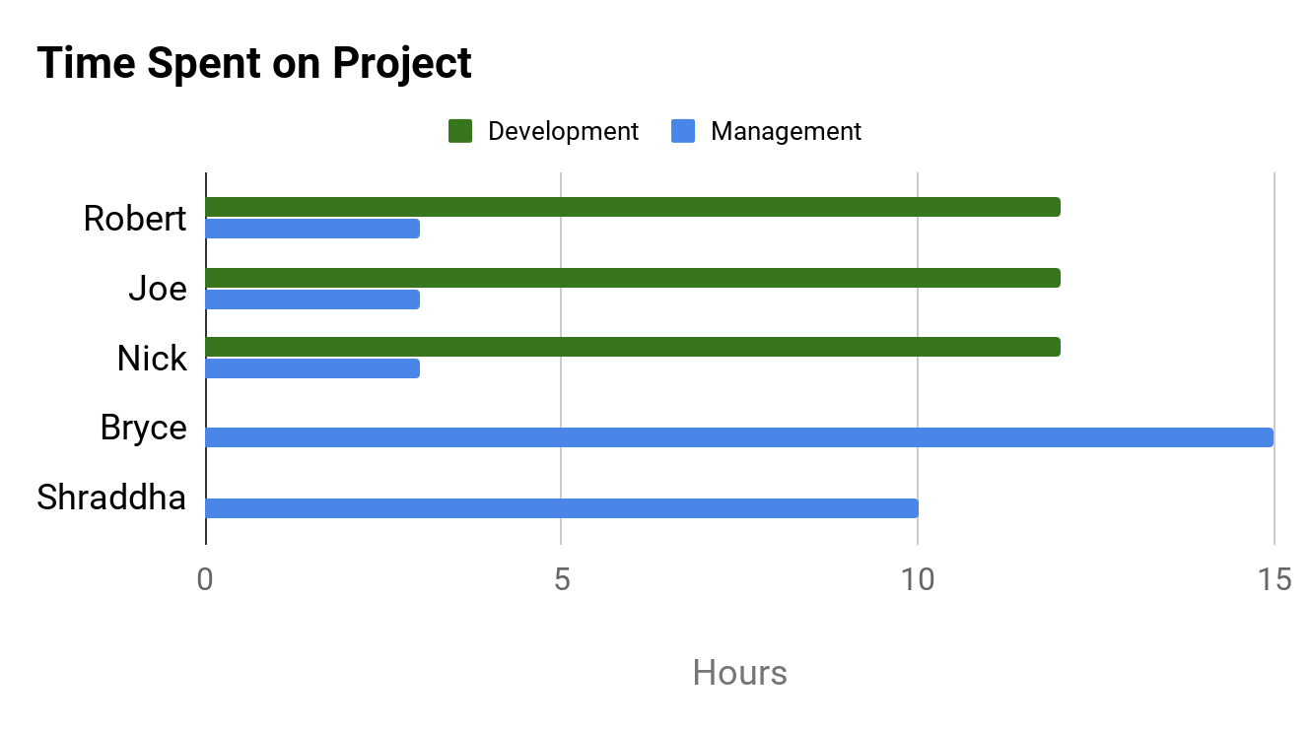
PROJECT DASHBOARD: HAX CMS MICROSERVICE
TEAM: #1
DATE: 19-APR-2020
PREVIOUS TASKS
On Target | At Risk | Attention Needed | Not Applicable
PROJECT STATUS
KEY PERFORMANCE INDICATORS
Documented technical specifications
Started RTM
Created full test scripts
Sent tests out for evaluation
On Target | At Risk | Attention Needed | Not Applicable
COMPLETED TASKS
Overall: On Target
Time: On Target
CURRENT TASKS
Scope: On Target
Review test results when received
Create training and handoff plans
Create presentation
Work on documentation
Cost: No Budget
RISK STATUS
TASK | PROGRESS
Create/Perform Tests
Create Training and Handoff Plans
Create Presentation
On Target | At Risk | Attention Needed | Not Applicable
Risk 1: Time Constraints
100%
ISSUES NEEDING ATTENTION
Risk 2: Lack of Development Support
No issues at this time
Risk 3: GitHub Change Compatibility
50%
Risk 4: Stray from Original Scope
Risk 5: Remote Collaboration
10%

